Slide 1
CCM Lab #3
Homework 1 review

Slide 2
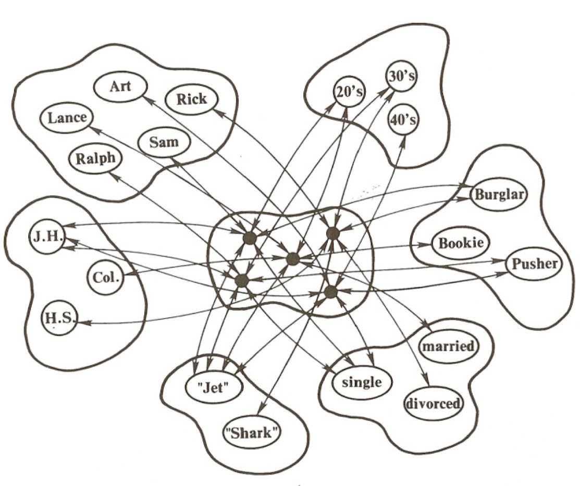
Part A (IAM)
Retrieval by name and by content
Spontaneous generalization over a set of familiar items

Slide 3
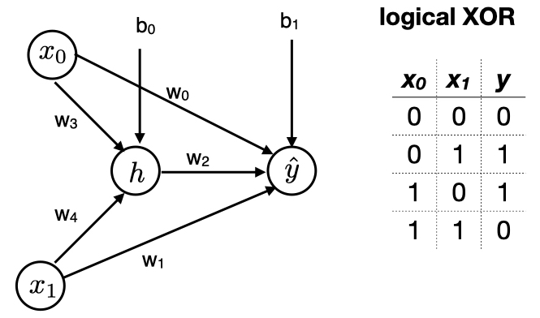
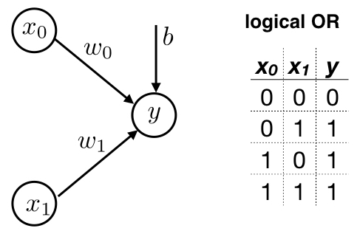
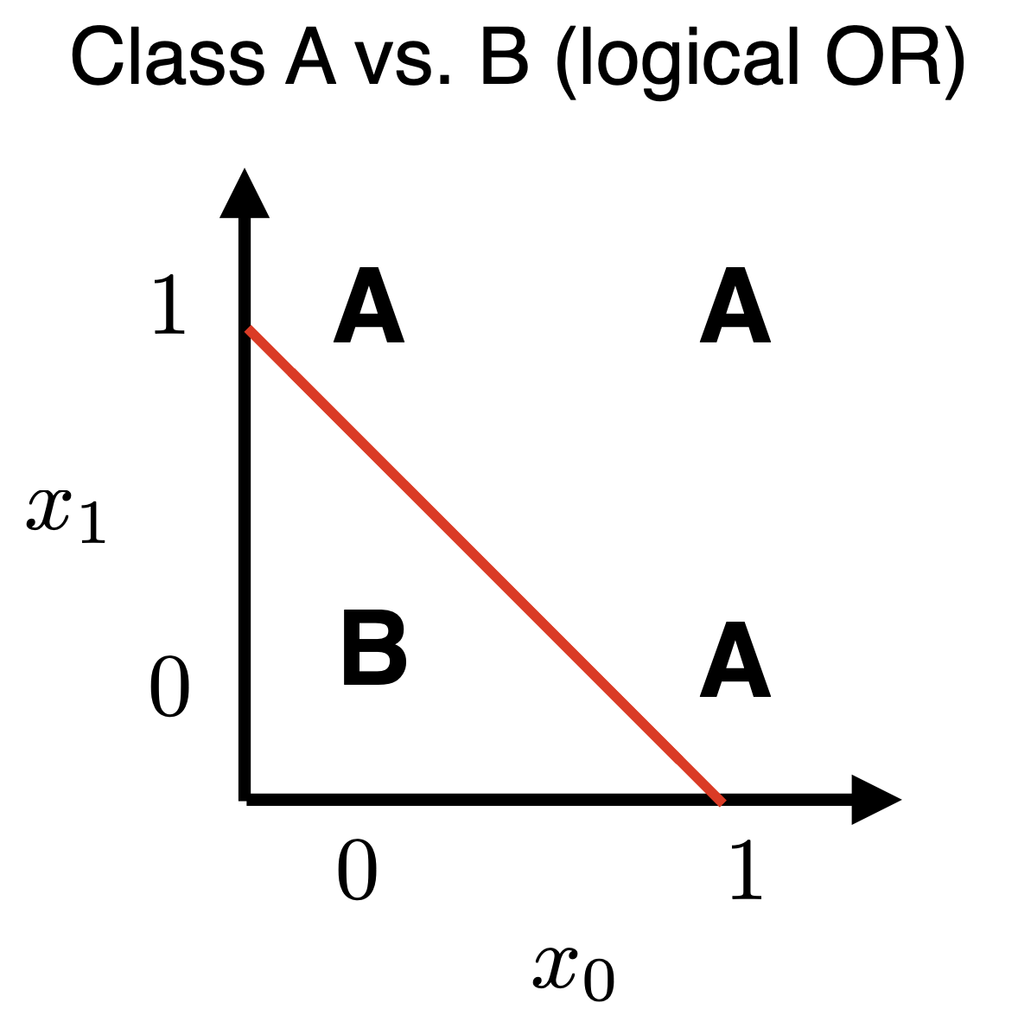
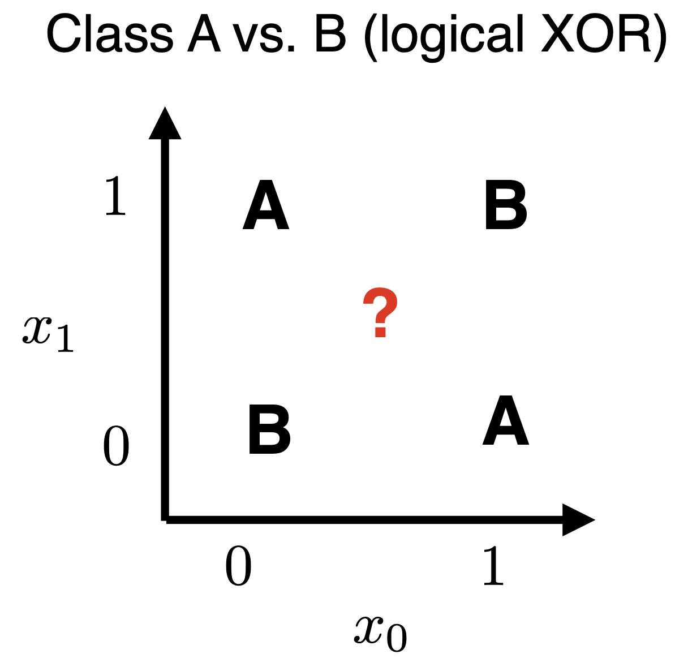
Part B

Slide 8
Part B (non-convex example)
https://losslandscape.com/explorer

Slide 11
Part B (putting it all together)
https://playground.tensorflow.org/

Slide 12
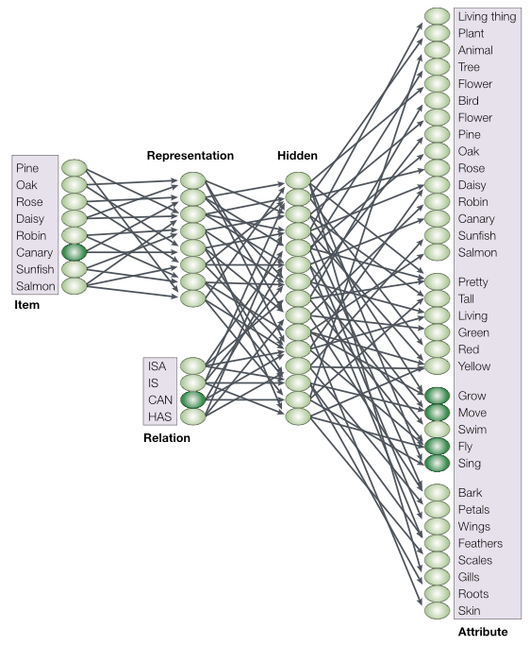
Part C (network architecture)
https://pytorch.org/tutorials/beginner/blitz/neural_networks_tutorial.html

Slide 13
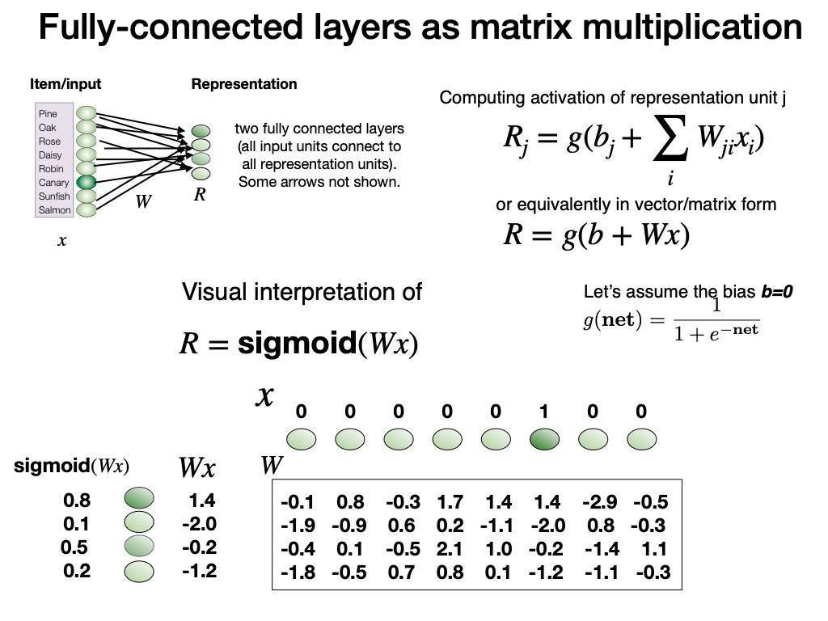

Slide 15
Part D (mnist dataset)
https://cs.stanford.edu/people/karpathy/convnetjs/demo/mnist.html

Slide 16
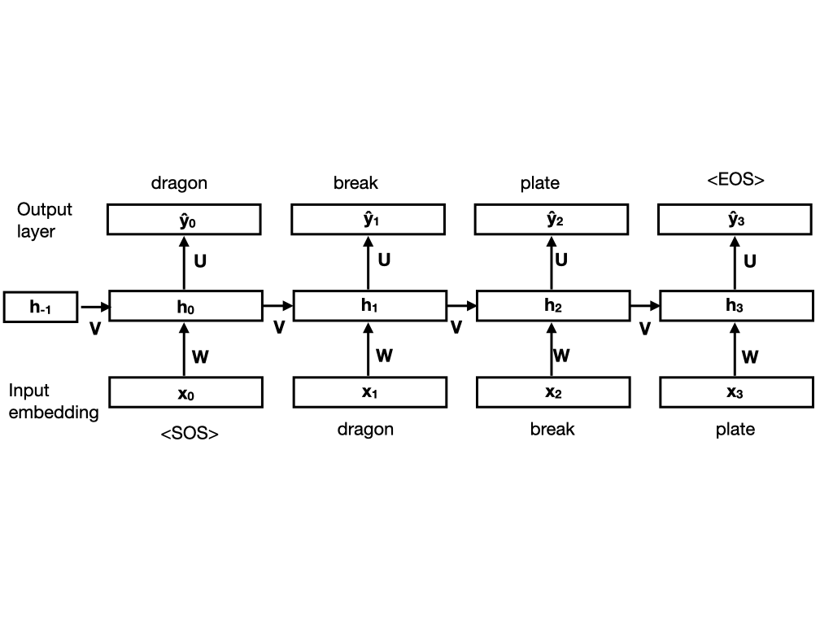
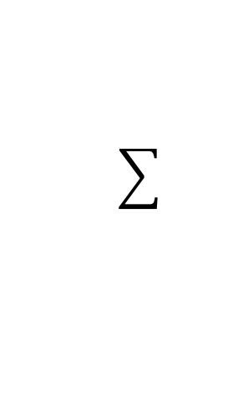
Part E (SRN)
E #1
E #2
E #3
E #4
For loop
Building blocks
repeat
repeat
repeat

Slide 18
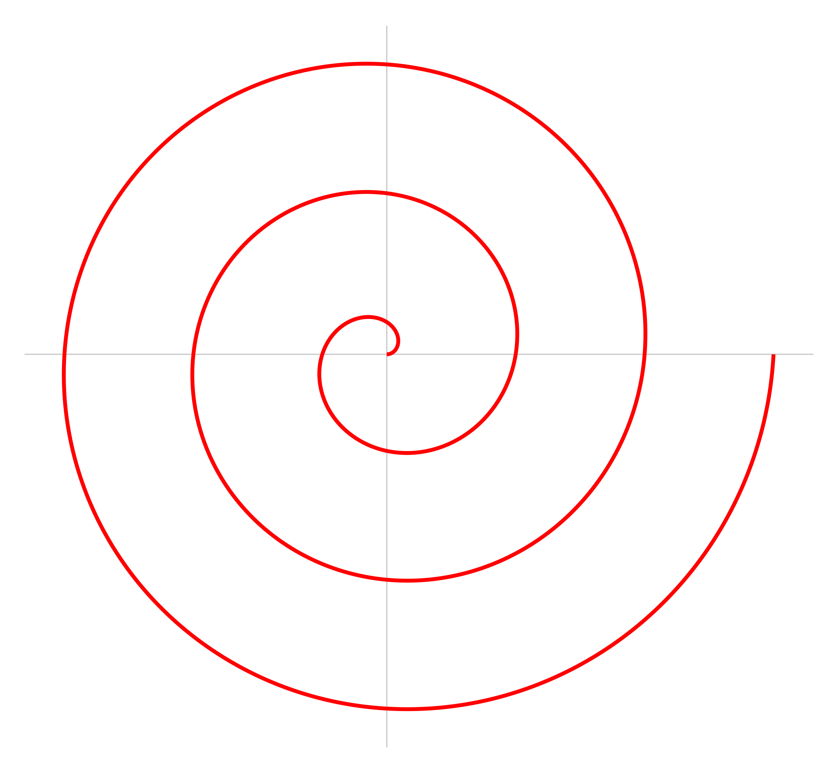
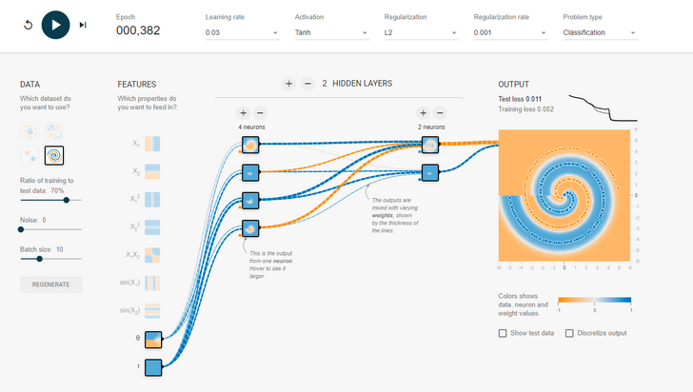
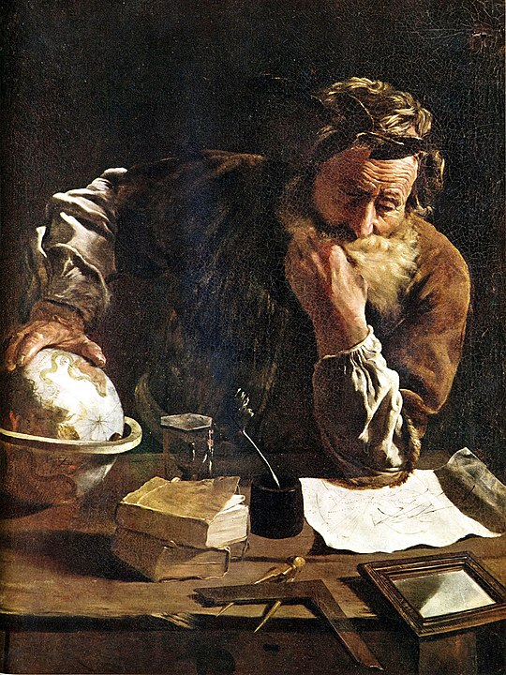
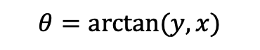
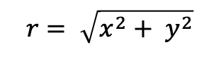
Spiral solution
$$r= \sqrt{x^{2}+ y^{2}}$$
$$θ=arctan⁡(y,x)$$
Archimedes (287-122 BC)

